Slide 1
VARIABLES, INPUT AND OUTPUT

Slide 2
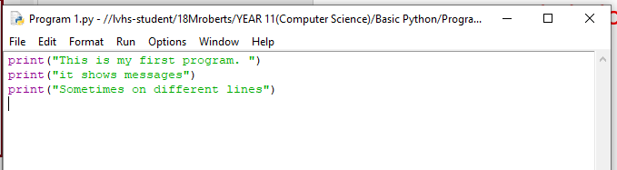
1. Display the following on 3 separate lines:
This is my first program.
It shows messages Sometimes on different lines
Paste your code below:

Slide 3
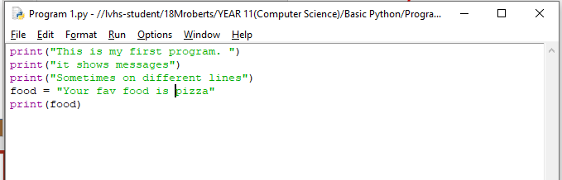
2. Create a variable called food and store your favourite food inside the variable. Print out the value of the variable onto the screen.
Paste your code below:

Slide 4
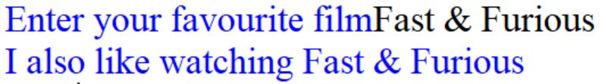
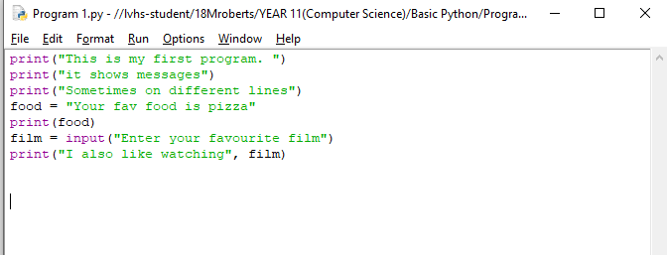
3) Ask the user for their favourite film. Display “I also like watching”, film. E.G:
Paste your code below:

Slide 5
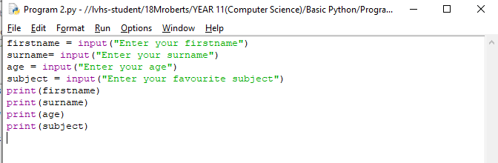
4. Create a program that ask the user for their firstname, surname, favourite subject and age then display the above on 4 separate lines. “Remember you can’t have space in a variable name.
Paste your code below:

Slide 6
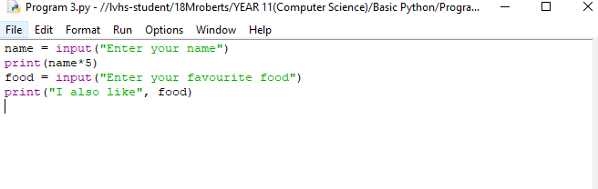
5. Create a program that ask the user for their name. Display the name 5 times on 1 line.
Paste your code below:

Slide 7
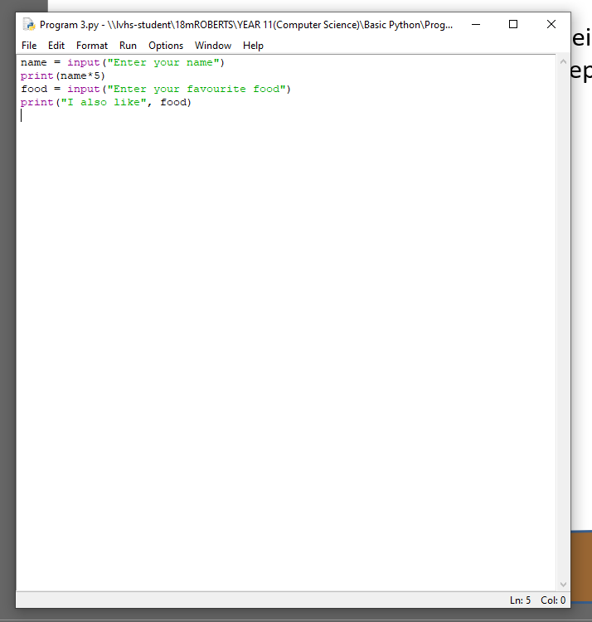
6. Create a program that ask the user for their favourite food. Display “I also like”, food. Food should be replaced with the user’s answer.
Paste your code below:

Slide 8
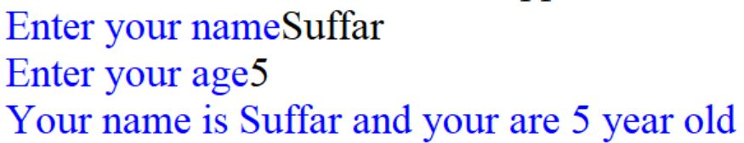
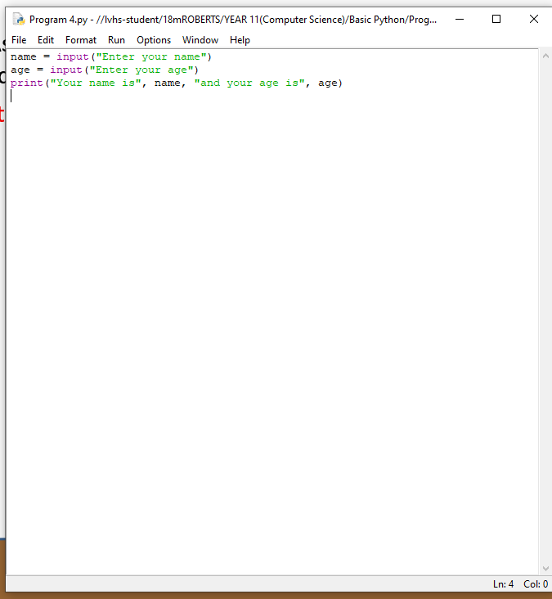
7. Ask for a user’s name and age. Display “your name is”, name, “and you are”, age, “year old”.E.G:
Paste your code below:

Slide 9

Data Types
String holds alphanumeric data as text.
Integer holds whole numbers.
Float/Real holds numbers with a decimal point.
Character holds a single, alphanumeric character.
Boolean holds either ‘True’ or ‘False’.
Data types, Boolean, Real, Character, Integer.
Notes:
Ask students to fill the box on a mini whiteboard

Slide 10
8. Complete the following table:
Data | Data Type
Age | Integer
House address | String
Name | String
Test tomorrow? Y/N | Character
Weight | Float
Price | Float
Is 5 == 5 | Boolean

Slide 11
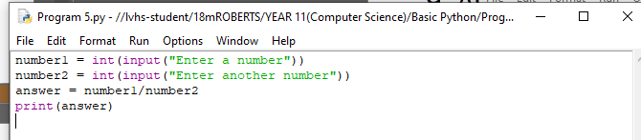
9. Ask the user for 2 numbers then divide the first number by the second number. Display the answer.
Paste your code below:

Slide 12
10. Asks for the width of a rectangle. Asks for the length of a rectangle. Calculates the area of a rectangle. Print the area of a rectangle.
Paste your code below:

Slide 13
11. Asks 2 users for their weight, calculate the average weight of the 2 users.
Paste your code below:

Slide 14
ARITHMETIC OPERATORS

Slide 15
12. Complete the following table:
Arithmetic operator name | Arithmetic operator symbol
Addition | +
Subtraction | -
Multiplication
Division
Exponent
Modulus
Floor Division

Slide 16
13. Create a variable x with a value of 5. Create a variable y with a value of 3. Create a variable z with a value 10. Multiply three numbers together and store them in a variable called answer. Comment on the code.
Paste your code below:

Slide 17
14. Alex has £20. Spending:£5 on pens. £3 on pencils. Total amount left?
Demonstrate this example using 4 variables and arithmetic operators. Comment on your code.
Paste your code below:

Slide 18
15. Ask how many apples the user wants. Ask how many people the user will share the apples with. Find out how many apples will remain if you share the apples equally. Hint: use modulus %.
Paste your code below:

Slide 19
16. Asks for the home team name. Asks for the opponent team name. Asks for the number of goals scored by the home team. Asks for the number of goals scored by the opposition team. Calculates the goal difference for the home team.
Paste your code below:

Slide 20
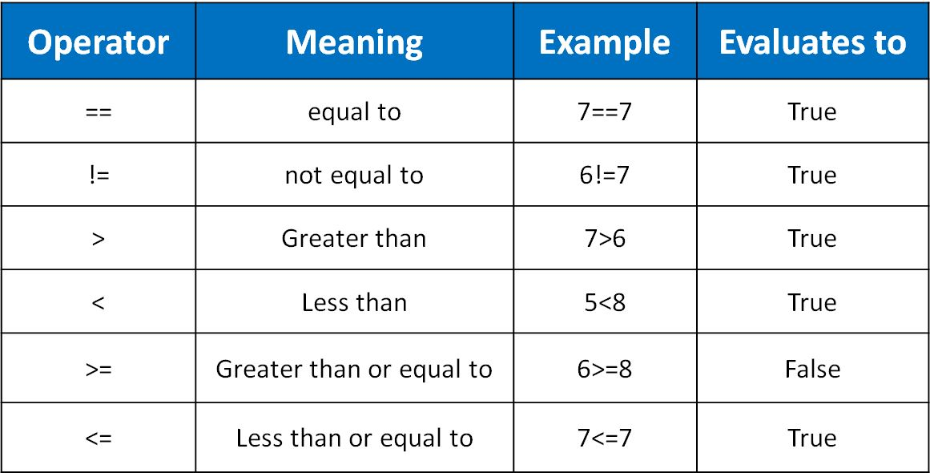
RELATIONAL OPERATORS
Equal to, not equal to, greater than, less than
Notes:
Give students 2 minutes to memorize relational operators. Go through each operator and explain it.

Slide 21
Relational operators
Question | True/False
5 == 3
2 != 5
5 > 6
8<2
2!=2
7==7
1>=1
7>=2
9<=2
9<=9

Slide 22
18. Use the code on the previous slide to complete the following table:
Answer (answer=_______) | Result
chocolate
biscuits
other
Sweets
crunchy
error

Slide 23
19. Mancity has scored 60 goals.
Manutd has scored 51 goals.
In total, Manutd has scored less goals than Mancity.
Create the above example in python to display True.
Paste your code below:

Slide 24
20. Create a program that asks for a person’s age. If the age is greater than or equal to 18, display “You are old enough to vote”, else display “You are not old enough to vote”.
Paste your code below:

Slide 25
21. Create a program that asks for a person’s name. If the name is equal to Tom, display “Welcome Tom”, else display “Hello stranger”.
Paste your code below:

Slide 26
22. Create a program that Greets the user.
Asks the user how they are feeling
If the user enters “happy”, print “glad to hear it”
If the user enters “sad” will tell the user a joke
Has an error message for any other entry
Paste your code below:

Slide 27
23. Ask user to enter a grade. If grade is >= 90, display A*, else if grade >= 80, display A, else if grade >= 70, display B, else if grade >= 60, display C, else display fail.
Paste your code below:

Slide 28
24. Ask the user for their favourite music band. Ask the user for their favourite song. Display the answers in a full sentence.
Paste your code below:

Slide 29
25. Ask the user to input 2 numbers. Multiple these 2 numbers together. Display the answer.
Paste your code below:

Slide 30
26) Create a program to allow the user to input a number. If the number is more than 100, print out a “too large” message, else display “too small”.
Paste your code below:

Slide 31
27) Ask a user to enter a football team. If the user enters Chelsea, display blue, else if user enters Liverpool, display red, else display team not registered.
Paste your code below:

Slide 32
28) Create a program to allow the user to input 2 numbers. If the first number is bigger than 10, add the two numbers, otherwise multiply the two numbers. Print out the result.
Paste your code below:

Slide 33
29) Allow the user to enter two numbers, then ask them if they want the numbers added or multiplied. Depending on their answer, print the right answer.
Paste your code below:

Slide 34
30) Ask a user whether they want to take the red pill or the blue pill. If they write “red” then print “red is the colour of blood”. Elif they write “blue” then print “Are you sick?”. Else print “I don’t like that colour”
Paste your code below:

Slide 35
31) Ask the user to enter traffic light colour, if colour is = red, display STOP, else if colour = yellow, display get ready, else if colour is = green, display GO, else display an error.
Paste your code below:

Slide 36
32) Create a program to ask the user to enter a username and password. If they get the username AND password right, display a “logged in” message. Otherwise, tell them they are wrong.
Paste your code below:

Slide 37
33) Ask the user if they play games on pc then ask them if they play on console, if pc = yes and console = yes, display Game master, else if pc = yes and console = no, display pc master, else if pc = no and console = yes, display console master, else display an error.
Paste your code below:

Slide 38
34) Ask for the user’s age. If age > 12 AND age < 20 then print “You are a teenager”. Else if the user is 11 or 12 year old, print “You are a tween.” Else print “Invalid age”.
Paste your code below:

Slide 39
35) Ask the user for current temperature. Ask the user if it’s raining outside. If temp is less than 12 degrees and it’s raining, display “Wear a coat and bring an umbrella”. Else if temperature is less than 12 degrees and it’s not raining, display “Wear a coat”. Else if temp is greater or equal to 12, and it’s raining, display bring an umbrella. Else display “you don’t need a coat or an umbrella”.
Paste your code below:

Slide 40
Python 2 programming tasks

Slide 41
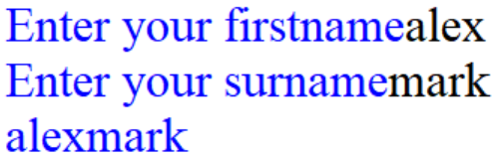
String manipulation - Concatenation
This simply means ‘joining’.
The ‘+’ sign joins together two or more string.
firstname = input("Enter your firstname")
surname = input("Enter your surname")
print(firstname+surname)

Slide 42
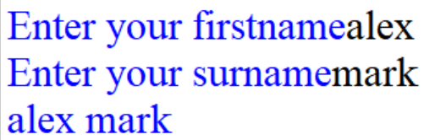
Concatenation
As you saw on the previous slide the “+” joined two strings together, however it did not add any space to it. In this case, we would concatonate with a comma “,”
firstname = input("Enter your firstname")
surname = input("Enter your surname")
print(firstname, surname)

Slide 43
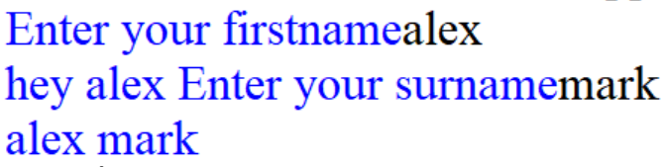
Concatenation
Why not just use a comma all the time?
firstname = input("Enter your firstname")
surname = input(firstname, " Enter your surname")
print(firstname, surname)
The above code will give you an error, because you can’t add a comma when storing a value in a variable because it will count it as an argument. However you can concatenate using “+” sign.
firstname = input("Enter your firstname")
surname = input("hey " + firstname+ " Enter your surname")
print(firstname, surname)

Slide 44
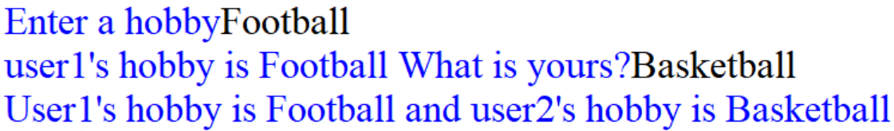
1. Ask the user for their favourite hobby. Ask another user for their hobby, use concatenation on this line. Display user1’s hobby is “…” and use2’s hobby is “…” use concatenation on this line.
Paste your code below:

Slide 45
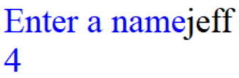
Length
This example program asks the user to input a name. It then finds the length of the string and stores it in the nameLength variable. The length of the string is displayed.
name = input("Enter a name")
nameLength = len(name)
print(nameLength)
© ZigZag Education, 2017

Slide 46
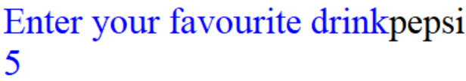
2. Ask the user for their favourite drink. Store the length of the string in a variable and display it on the screen.
Paste your code below:

Slide 47
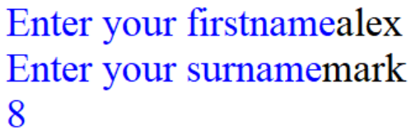
3. Ask the user for their firstname and store it in a variable. Ask the user for their surname and store it in a variable. Concatenate the two strings together without space. Display the length of firstname+surname.
Paste your code below:

Slide 48
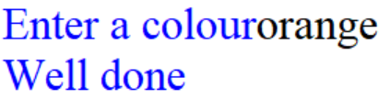
3.5. Ask the user to enter a colour that contains 6 letters. If the user enters the correct answer. Display “Well done”, else, display incorrect.
Hint: len(colour)
Paste your code below:

Slide 49
Substring
This can be used to extract a specific part of a string.
Index | 0 | 1 | 2 | 3
Character | m | a | r | k
The following would display “ma”
name = "mark"
print(name[0:2])
Up to but not included
Starting position

Slide 50

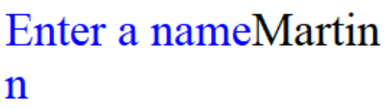
Substring
name = input("Enter a name")
print(name[0]) #displays the first character.
name = input("Enter a name")
print(name[-1]) #displays the last character.

Slide 51
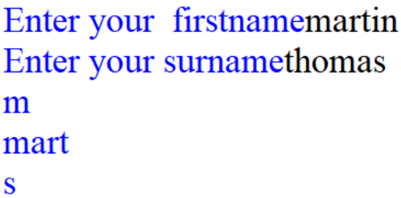
4. Ask the user for their firstname and store it in a variable. Ask the user for their surname and store it in a variable. Display the first letter of the user’s firstname. On a separate line, display the first 4 letters of the user’s firstname. On another line, display the last letter of the user’s surname.
Paste your code below:

Slide 52
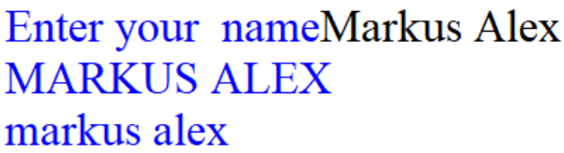
Case Conversion
The following will display the name in capital letters and in lowercase on separate lines.
name = input("Enter your name")
print(name.upper())
print(name.lower())

Slide 53
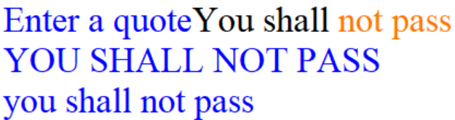
5. Ask the user for a quote. Display the quote in uppercase and lowercase on separate lines.
Paste your code below:

Slide 54
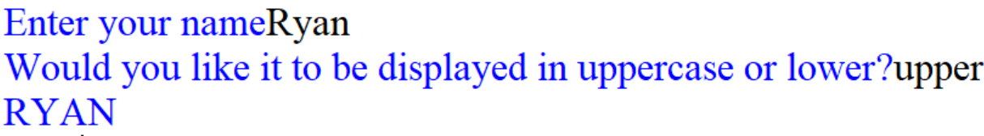
6. Ask the user for their name. Ask the user if they want their name to be displayed in capital letters or lowercase. Display the user’s name depending on their answer.
Paste your code below:

Slide 55
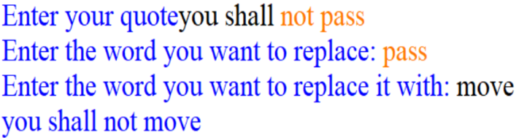
6.5) asks the user to enter a quote. Asks the user to input:
the word they want to replace
the word they want to replace it with
Print the final quote. Hint: quote.replace(word1,word2)
Paste your code below:

Slide 56
String manipulation
.title() - Capitalize each word in a string
.isupper() - Find out if a string is all in uppercase
.islower() - Find out if a string is all in lowercase
.isalpha() - Check whether a string contains only letters.
.isdigit() - Check whether a string contains only numbers.
.isspace() - Check whether a string only contains spaces.
.capitalize() - Capitalize a string (make first letter capital).
Example: name = input("Enter a name")
print(name.capitalize())

Slide 57
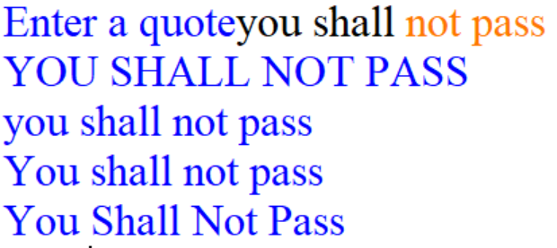
7. Create a program that will allow the user to enter a quote by a famous person. Output this quote in upper case, lower case, capitalize and title formats.
Paste your code below:

Slide 58
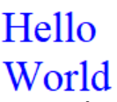

Formatting text
\n - This adds a new line. Example:
print("Hello \nWorld") would display:
\t - The t stands for “tab” which adds extra space. Example:
print("Hello \tWorld") would display:

Slide 59
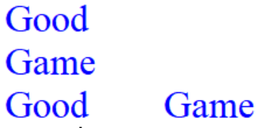
7.3) Display Good Game on 2 separate lines using \n and 1 print command. On another line separate Good from game using \t using a second print command.
Paste your code below:

Slide 60
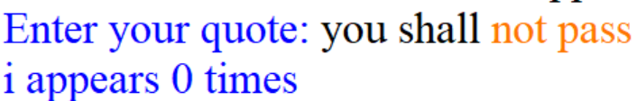
7.5 Ask the user to input a quote. Display the number of times the letter i occurs in the quote in a full sentence. Hint: quote.count("i")
Paste your code below:

Slide 61
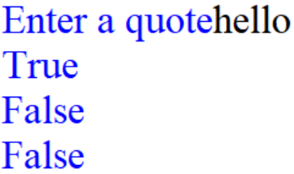
8. Create a program that will allow the user to enter a quote by a famous person. On separate lines, check if the quote contains letters, space, digits.
Paste your code below:

Slide 62
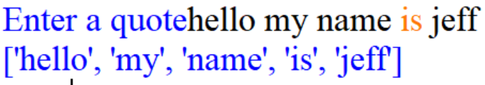
String manipulation
The following will split a string into a number of items on a list.
quote = input("Enter a quote")
print(quote.split())

Slide 63
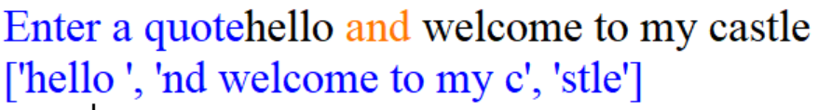
String manipulation
The following will split a string into items on a list around a specific letter.
quote = input("Enter a quote")
print(quote.split("a"))

Slide 64
8.5. Ask the user to enter their favourite hobby in a sentence. Split the sentence at the letter “f”.
Paste your code below:

Slide 65
Iteration – For loop Counter variable.
The counter variable in Python starts at 0!!!
So…. for x in range(9) :
print (x)
Will actually count from 0 to 8…

Slide 66
The following will display the times table of the user’s answer from 0 to 9.
number = int(input("Enter a number"))
for c in range(10):
print (c * number)

Slide 67
FOR with different values
You can change the start value of the for loop.
for x in range(5, 10) :
print(x)
This will loop around from 5 to 9 (the ending value is never included!)

Slide 68
FOR with different steps
You can change the steps that each loop around will change the counter value by
for x in range(5, 100, 10) :
print(x)
This will loop around from 5 to 99 counting in steps of 10 (the ending value is never included, so it will actually stop at 95)

Slide 69
FOR with different steps
And going down!
for y in range(100,0,-1) :
print(y)
This will count from 100 down to 1.

Slide 70
9. Create a program that counts from 1 to 100.
Paste your code below:

Slide 71
10. Create a program that counts down from 100 to 1.
Paste your code below:

Slide 72
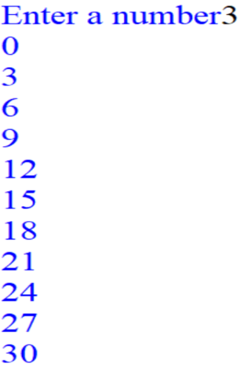
11. Ask the user for a number. Display the times table of that number up to the number 10.
Paste your code below:

Slide 73
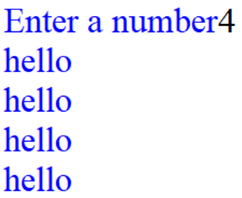
12. Ask the user for a number. Repeat ‘Hello’ a certain number of times, based on a number entered by the user.
Paste your code below:

Slide 74
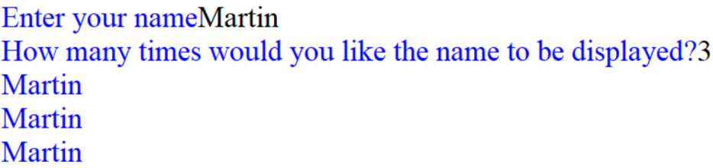
13. Ask the user to enter a name. Ask the user how many times they want their name to be displayed. Display the user’s name repeatedly depending on the user’s answer.
Paste your code below:

Slide 75
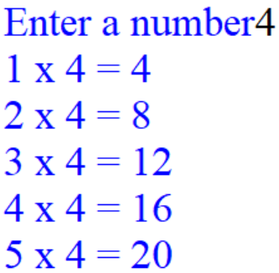
14. Ask the user for a number. Display the times table of that number from 1 to 5 in the following style:
Paste your code below:

Slide 76
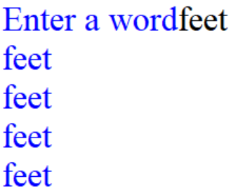
15. Ask the user to enter a word and store it in a variable called word. For each letter in that word, print the word. Hint: use for i in word:
Paste your code below:

Slide 77
Q16 helpsheet
hobby = input("Enter a hobby in a sentence")
split = hobby.split("a")
for i in range(len(split)):
print(split[i][0])

Slide 78
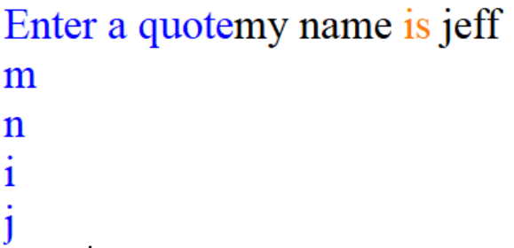
16. Ask the user to enter a quote. Split the quote at every “space”. Display the first character in the quote after every space.
Paste your code below:

Slide 79
17) Write a program that displays all odd numbers between 1 and 99
Paste your code below:

Slide 80
18) Ask the user their name and their age. Print their name the number of times as their age.
Paste your code below:

Slide 81
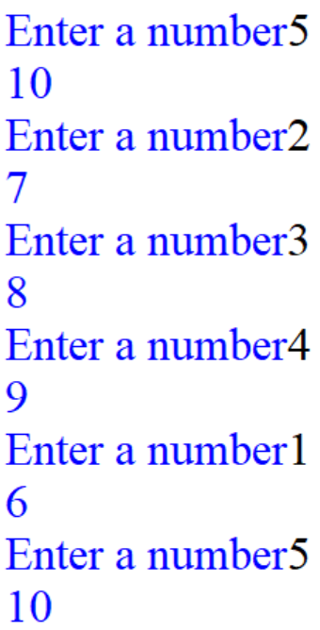
19) Write a program that asks the user to enter a number and then adds 5 to this and prints out the result. Make the program ask the question 6 times.
Paste your code below:

Slide 82
20) Ask “how many negatives did you get?” if answer is 1, display prompt 10 times. Else if answer is 2, display reminder 50 times, else if answer is 3, display warning 100 times, else display removal 500 times.
Paste your code below:

Slide 83
21) Ask for the user’s age. If age is greater than 12, display happy birthday 100 times. Else display happy birthday 12 times.
Paste your code below:

Slide 84
WHILE LOOPS
Condition controlled.

Slide 85
WHILE
The WHILE statement is used to loop around code as long as certain criteria are fulfilled. For example:
while x > 7:
this code will be repeated
so will this code
This code will not be repeated
Note that indenting (using the TAB key) is used to decide what code is inside the while statement.

Slide 86
22) Use a while loop to create the 2 times table up to 100. Display “You have finished” when you get to the number 100.
Paste your code below:

Slide 87

23) Display “Hey” and “Bye” on separate lines 1000 times using a while loop.
Paste your code below:

Slide 88
24) Ask the user to input 4 names. Display “You have entered 4 names” when the user inputs all 4 names.
Paste your code below:

Slide 89
25) Ask the user to input a password. If password is correct, display correct password. If password is incorrect, display incorrect password. Display “LOCKED” after 4 attempts.
Paste your code below:

Slide 90
26) Ask the user to input a password. If password is correct, display correct password. If password is incorrect, display incorrect password. The program will loop until the correct answer is entered. Hint: use attempts = False Paste your code below:

Slide 91
27)
1- Ask the user for a username.
2- While the username is less than 8 characters long,
3-Display “Invalid username, enter another username”) and force the user to enter another username.
4- Display “your username has been accepted” if the username is at least 8 characters long.
5- Ask the user for a password.
6- While the password is less than 8 characters long OR greater than 15 characters long,
7- display “Invalid password, enter another password”) & force the user to enter another password.
Display “your password has been accepted” if the password is between 8 and 15 characters long.
Hints: use while len(password) < 8 or len(password) > 15:
Paste your code on the next slide:

Slide 92
Paste your code below:

Slide 93
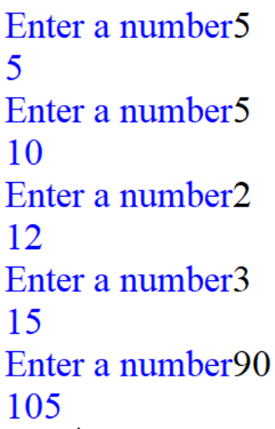
28) Write a program that allows the user to type in a number. This number will then be added onto a total, which will be displayed. Continue to ask for a number until the total is over 100.
Paste your code below:

Slide 94
RANDOM NUMBER PICK
To pick a random number between 1 and 100, use this code :
import random
x = random.randint(1,100)
print(x)
This will give x a random value between 1 and 100.

Slide 95
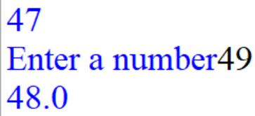
29) Store a random number from 1 to 100 in variable using random.randint. Ask the user for a number between 1 to 10 and store it in another variable. Calculate the average of these 2 numbers. Display the average.
Paste your code below:

Slide 96
30) Guessing game. Store a random number between 1 and 100 in a variable using random.randint(1,100). Ask the user to guess it. Display a “too high”, “too low” or “well done” message. Keep asking the question until they get it correct.
Fill the gaps in the code on the next slide.

Slide 97
import random
random = _____________ # stores a random number.
number = int(_____________))
while True: # infinite loop.
if number > random:
print(__________)
number = int(input("Enter a number"))
elif number < random:
print(__________)
number = int(_______________))
else:
print(__________)
break #breaks out of loops.

Slide 98
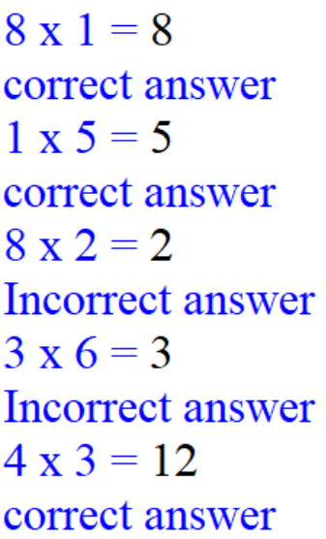
31) Store 2 random numbers in 2 different variables. Ask the user to work out the answer when these two numbers are multiplied. Mark their answer as right or wrong. Repeat this 5 times using a for loop.
Fill the gaps in the code on the next slide.

Slide 99
import __________
for i ________:
first = random.randint(1,10)
second = _______________
answer = __________
guess = int(input(str(first)+" x " + str(second)+ " = "))
if guess == ________:
print(__________)
else:
print(_______________)

Slide 100
Lists and arrays.
1D ARRAYS

Slide 101
Theory: Understanding Arrays
students = [“Bilal”, “Ahmed”, “Martha”, “Sam”, “Billy”, “Tom”]
Array: A collection of values (elements) stored in one location under a common identifier.
Student1= Bilal
Student2= Ahmed
Student3= Martha
Student4= Sam
Student6= Billy
Student7= Tom
print (students[2])
Martha
print (students[5])
Tom
print (students[0])
Bilal
print (students)
[‘Bilal’, ‘Ahmed’, ‘Martha’, ‘Sam’, ‘Billy’, ‘Tom’]
Array, variable, data, identified

Slide 102
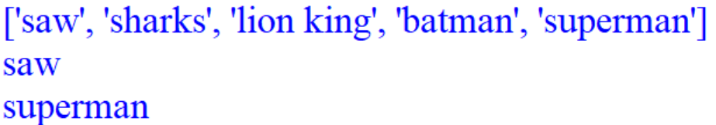
32) Write a program that has a list which holds your top 5 favourite films. Display all 5 films. Display the first film in the array on a separate line. Display the last film in the array on a separate line.
Paste your code below:

Slide 103
33) Create a program that stores 7 numbers in an array. Display the 4th number in the array.
Paste your code below:

Slide 104
We can display each item in the array separately using a for loop.
array = ["saw","batman","superman"]
for x in array:
print(x)

Slide 105
We can loop through an array using a for loop.
array = ["saw","batman","superman"]
film = input("Enter a film to see if it's in the array")
for i in range(len(array)):
if film == array[i]:
print ("found")

Slide 106
34) Write a program that checks whether an element occurs in a list. For example: array = [4, 6, 7, 8, 10]. Which number would you like to find? 10 Found!
Paste your code below:

Slide 107
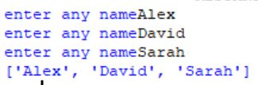
Append means add (something) to the end.
#Declare an empty array
student = [ ]
#Loops through the array starting with 0.
for i in range(0,3):
student.append(input("enter any name"))
#Print the array
print(student)
array, value, element, variable, assigning, data structure, efficiency

Slide 108
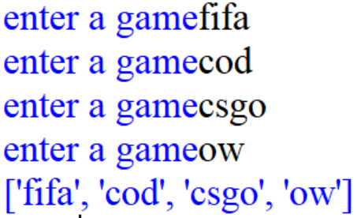
35) Write a program that asks the user to enter the name of 4 games and store these within an array. Display the array.
Paste your code below:

Slide 109
Slicing:
array = [2,3,4,5]
print(array[:2]) #prints index 0 & 1 print(array[2:]) #prints index 2 & 3
print(array[1:3]) #prints index 1&2
Array, append, slice, remove

Slide 110
35.5) Create an array containing the towns Barton, Uttoxeter and Loxley. Print off just the first and then last towns in the array and then the first two towns on separate lines.

Slide 111
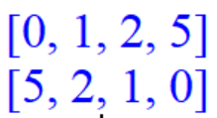
Sorting:
array = [1,2,0,5]
array.sort()
print(array)
array.reverse()
print(array)
Sort the list in number/alphabetical order.
Sort the list in reverse order.
Array, append, slice, remove, sort, reverse

Slide 112
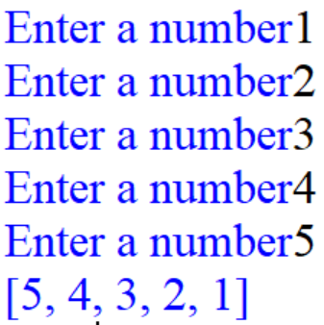
36) Write a program that will accept five numbers from the user and store these within a list. Reverse the order of the list then display the list. Hint: use array.reverse()
Paste your code below:

Slide 113
37) Ask the user to enter 3 games and store it in an array. Sort the list in alphabetical order. Hint: array.sort()
Paste your code below:

Slide 114
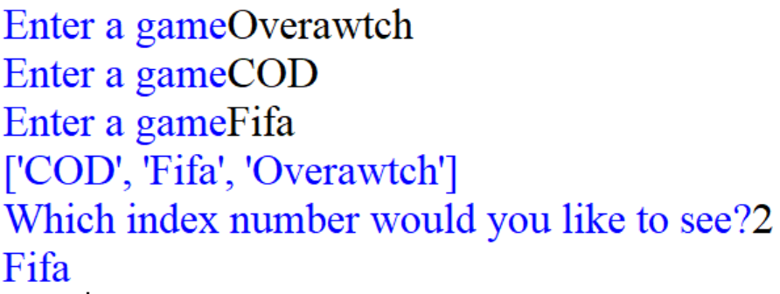
37.5) Extend your previous program so that after adding the games, the user is asked which index number they want to see. This game is then printed out. For example, if they enter 3 then they should be shown the 3rd game in the list.
Hint: print(array[number-1])
Paste your code below:

Slide 115
examples!
In all of these examples, replace arrayname with the name of your array/list.
Python code | What does this do?
arrayname.remove(“Steve”) | Removes an item from the array
arrayname.insert(4, “Bill”) | Inserts an item at the index position given.
arrayname.sort() | Sorts the data into order
len(arrayname) | gives the number of items in the array

Slide 116
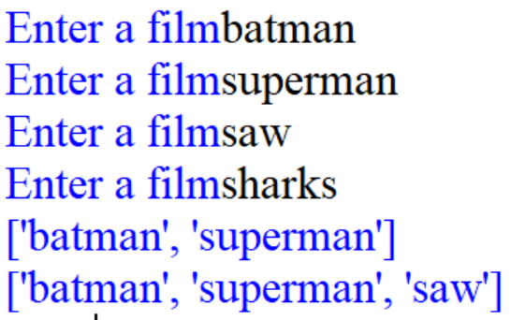
38) Write a program that asks the user to input the name of 4 films and store them in a list. Display the first 2 films in the list. Remove the last film in the list hint: use array.remove() . Display the list then display the first film only.
Paste your code below:

Slide 117
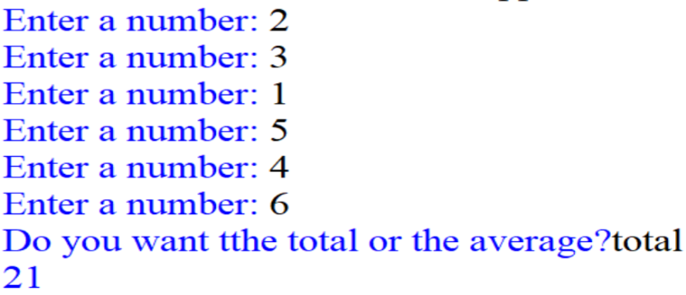
38.5) Ask the user to enter 6 numbers which are then stored in an array. The user should then be able to choose to see either the total or the average of these numbers. Print out the answer.
Paste your code below:

Slide 118
38.5) If you are struggling with the question use the code below:
score = []
for i in range (__):
number=______________
score.append(____)
option = _________________
total = score[0]+______________
if option == "total":
print(_____)
elif option == "average":
print(______)
else:
print("Invalid option")

Slide 119

38.6) Create a questionnaire program that asks the user for their gender and gives the options MALE/FEMALE/QUIT. Store the answer in an array. Keep asking the question until someone enters QUIT. Then print out the total number of people who answered the question, the number of males and the number of females. Use the code on the next slide if you are struggling.
Paste your code on the next slide:

Slide 120
Q38.6)
males = _
females = _
storage = []
gender = ____________
storage.append(_____)
while gender.lower() == "male" or ____________________:
gender = input("Are you a male or female, or quit? ")
____________(gender.lower())
if gender.lower() == "quit":
for item in storage:
if item.lower() == _______:
males = _____ + 1
else:
if _______== "female":
females = females + ___
print(str(males) +" males")
print(str(females) +" females")

Slide 121

38.7) Create a program to store the names of computer games that they play in an array. Create a simple menu system to allow the user to either add, edit or delete a game. Also allow the user to print the array whenever needed.
Use the code on the next slide if you are struggling.
Paste your code on the next slide:

Slide 122
games = []
while True:
menu = input("\nDo you want to add, edit or delete a game, or print all games? ")
if _____ == "add":
newgame = input(___________)
games.append(________)
print("Game '"+newgame +"' added. ")
elif menu == "print":
print("Your games are: ")
print(_______)
elif _____ == "edit":
print("Your games are: "+str(games))
editone = input("Which one do you want to edit?")
edittext = _____("What do you want to change it to?")
games.______(editone)
games.______(edittext)
elif _____ == "delete":
print("your games are: "+str(games))
delete = input("Which game would you like to delete?")
games.______(_____)
____:
print("Invalid option")
Q38.7)

Slide 123
2D ARRAYS

Slide 124
array = [ [3,2,1], [2,3,4], [7,5,2] ]
print(array[2][1])
#This will display the number 5.
Array, append, slice, remove

Slide 125
array = [ [3,2,1], [2,3,4], [7,5,2] ]
print(array[0][1])
#This will display the number 2.
Array, append, slice, remove

Slide 126
Two-dimensional array.
Student name | Grade1 | Grade2 | Grade3
Alfie Little | 24 | 32 | 5
Billy Bob Junior II | 22 | 22 | 53
Daft Muppet | 43 | 54 | 23
King Plonker | 23 | 12 | 32
grades = [["Alfie Little",24,32,5],["Billy Bob Junior II", 22,22,53], ["Daft Muppet",43,54,23], ["King Plonker", 23,12,32]]
print(grades) # displays the list.
print(grades[1][2]) # displays 22
grades[1].append(56) # adds 56 to billy
array, element, table, assigning, identifier

Slide 127
39) Write a program that converts the following table into a two-dimensional array called ‘grades’:
Paste your code below:
Student name | Grade1 | Grade2 | Grade3
Alfie Little | 24 | 32 | 5
Billy Bob Junior II | 22 | 22 | 53
Mark Jones | 43 | 54 | 23
King Plonker | 23 | 12 | 32

Slide 128
40) Modify Mark Jones Grade2 to 76 from the previous question. You will need the following: grades[index][index] = 76
Paste your code below:

Slide 129
41) Add ‘Grade4’ to your array with the following data: You will need the following: grades[x].append(value)
Paste your code below:
Student name | Grade4
Alfie Little | 37
Billy Bob Junior II | 99
Mark Jones | 32
King Plonker | 42

Slide 130
42) Add to your previous code “question” to calculate the average for grade1, grade2, grade3, and grade4 for Alfie Little. Display the outcome.
Paste your code below:

Slide 131
43) This two dimensional array holds the current level each pupil is working at.
Develop a program that initialises the two dimensional array. Display the array.
Remove Emma Baldridge from the array as she no longer attends the school then display the array. hint: x.remove
Add a new student “Jonathan Pierce” and his current grade as “5+”. x.append
Display the new array.
Fill the gaps on the next slide.
“Alex Chadwick” | “7+”
“Seema Patel” | “5-”
“Dion Scott” | “6-”
“Emma Baldridge” | “8”
“Gareth Wild” | “8+”

Slide 132
43)
Fill the gaps.
pupils = [["Alex Chadwick","7+"],["Seema Patel","5-"],
["Dion Scott","6-"],["Emma Baldridge","8"],
["Gareth Wild","8+"]]
print(_______)
pupils.remove(________)
print(_______)
pupils.append([])
______[_].append("Jonathan Pierce")
______[_].append("5+")
print(______)

Slide 133
Mixed tasks

Slide 134

44) Ask the user to enter the name of 3 singers, stores them in an array and then display one of them at random. Hint: random.randint(0,2)
Paste your code below:

Slide 135

45) Ask the user to enter the name of 3 singers, stores them in an array. Sort the array in alphabetical order then display each singer in the array on a separate line with their position.
Hints: array.sort() & len(array)
Paste your code below:

Slide 136

46. Ask the user to enter a game, then output the numbers from 0 to the number of characters in the game entered. Display each number on separate line.
Paste your code below:

Slide 137

47. Ask the user to enter a quote. Split the quote into individual words by the spaces. Display each word on a new line.
Paste your code below:

Slide 138

48. Create a random number generator that generates 5 random numbers and displays it on the screen. Store the numbers in an array. Sort the list in order then display it.
Hint: use array.append and a for loop.
Paste your code below:

Slide 139

49. Random number generator. Ask the user how many numbers they want to generate. Ask the user for the lowest and highest number they want to generate. Display each number generated. Store the numbers in a list. Display the list in reverse order. Hint: array.reverse
Paste your code below:

Slide 140
Python 3 programming tasks

Slide 141
FILE HANDLING Writing to a file
Opens/create a file
File name
Tells the program we want to “write”
Variable/file handler
file = open("test1.txt", "w")
file.write("Hello World\n")
file.write("Good Day")
file.close()
Move to a new line.
Write inside the file.
Values/text that will be inside the file.
Closes the file
text file, data file, read, write, variable
Notes:
Demonstrate this example in python before this slide. Ask students about each part “commenting”.

Slide 142
1. Write a program that writes your top three films of all time, to a text document. Write each film on a separate line.
Paste your code below:

Slide 143
2. Write a program that asks the user for their name and then writes the name to a text document.
Paste your code below:

Slide 144
Reading from a file
File name
Tells the program we want to “read”
Opens the file
Variable/ file handler
fileReading = open("test1.txt", "r")
Read = fileReading.read()
fileReading.close()
print(Read.lower())
Read whatever inside the file into the variable Read.
Closes the file
Display the values/text in lower case.
Can be changed to upper also to display in capital letters.
text file, data file, read, write, variable

Slide 145
3. Create a program that asks the user to list their top 3 songs and store it in a text file. The program will then read the entire text file and displays it to the screen.
Paste your code below:

Slide 146
4. Ask the user to specify a filename. The program will then ask the user to specify a sentence to write. The file will be created and the sentence written to it. Display the sentence in both lowercase and upper case.
Paste your code below:

Slide 147
5. Ask a user if they want to read or write. If they answer read, the filename specified is opened and the contents of the file is read and displayed to the screen. If they answer write, then ask the user to write a sentence to the file. Hint: use if statement & create a .txt file in advance.
Paste your code below:

Slide 148
Appending “adding to the end” data to a file.
Variable/file handler
Opens/create a file
Tells the program we want to “append”
File name
dataFile = open("data file 1.txt", "a")
dataFile.writelines("11")
dataFile.close()
Write inside the file.
Values/text that will be appended to the file.
Closes the file
text file, data file, read, write, variable

Slide 149
6. Ask a user for their first name and second name and store that in a txt file. Close the file. Ask another user for their name and address. Append that to the same file.
Paste your code below:

Slide 150
7. Update your last program by adding the following at the end of your program on a new line: Alex hunter
Paste your code below:

Slide 151
8. Ask the user to input 5 numbers and append these to the end of the text file. Hint: use a for loop.
Paste your code below:

Slide 152
9. Ask 4 users for their name. Store this in an array. Write all 3 names on separate lines in a file by looping “for loop” through each name in the array. Close the file.
Paste your code below:

Slide 153
10. Ask the user how many numbers they want to enter. Let them enter this many numbers and write them to a text file. Each number must be on a separate line.
Paste your code below:

Slide 154
11. Write a program that asks the user for their personal details including: first name, surname, age and address. Store them in a file.
Paste your code below:

Slide 155

12. Ask the user to enter the name of 5 different games. Store them in a file. Read the data from the file and store it in a list. Separate each of them by a comma.
Paste your code below:

Slide 156


13. Create a text file named team.txt and store 8 football team names and their best player, separate the player from the team name by a comma.
Create a program that reads from the text file and displays a random
team name and the first letter of the player’s first name and the first letter of their surname.
Paste your code below:

Slide 157
Q13 Helpsheet
import ______
teamList = _____("team.txt", "__")
data = teamList._______()
randomChoice= random._______(____)
teamName =[]
player =[]
for lines in data:
split = lines._____(',')
teamName.______(split[0])
player._______(_____[1])
teamName = teamName[_______]
letters = _______[randomChoice]
print("\nThe team is ",______)
splitLetters = letters._____(' ')
print("And the first letter of the player’s firstname and surname is")
for x in range(_____(splitLetters)):
print((______[x][_]).upper())

Slide 158
14. Write a program that allows the user to create and store a checklist for their homework. Ask for pupil’s name, and create a text file using the pupil’s name.
Ask how many homeworks they need to complete. The user should then be able to enter each homework name. Store them in a file.
Paste your code below:

Slide 159
Q14 Helpsheet
homework=[]
name=__________
homeworkNum=__________
for i in range(0,_____):
homework._____(input("Enter the name of homework "+str(i+1)+": "))
file = _____((name+".txt"), "_")
for item in ______:
file.write(_____+"\n")
file._____()

Slide 160
Procedures
A subroutine or a subprogram is a named self-contained section of code that performs a specific task.
Parameters: Specific variables used to pass values into a sub program.
Arguments: Actual values that the parameters take when the sub program is called.
Procedure, function, subroutine, subprogram, return, parameter

Slide 161
PROCEDURE
Function/procedure name
def is a command which allows you to define a new function / procedure.
Ask the user to input a name.
def firstSubroutine():
name=input("what is your name")
print(name)
firstSubroutine()
firstSubroutine()
Calls the procedure. This will run line 2 and 3.
Displays the user’s answer.
Procedure, arguments, subroutine, subprogram, parameter

Slide 162
PROCEDURE
Function/procedure name.
Parameter.
def is a command which allows you to define a new function.
def welcome(name):
print(“Welcome to school“ , name )
welcome("Alex")
welcome(“Tom")
Displays welcome to school + the value of the argument.
Calls the procedure. This will run line 2.
Argument.
Procedure, arguments, subroutine, subprogram, parameter
Notes:
Ask the students to code it then explain it.

Slide 163
Parameter passing
Values can be passed from the main program to the parameters in a procedure/function.
Parameters
def calculate(num,num2):
print(num * num2)
calculate(2,4)
Local Variable
The values 2 and 4 are passed into num and num2.

Slide 164
Variable Scope
Global: Declared outside any subroutines and accessible throughout the program, including inside subroutines.
Local: Declared within a subroutine and are only accessible within that subroutine.
Local variable
def calculate(num):
number1 = int(input("Enter a number"))
print(number1*num)
number = int(input("Enter a number"))
calculate(number)
Local Variable
Global variable

Slide 165
15. Create a procedure that will ask the user for their name. Display the name.
Paste your code below:

Slide 166

16. Create a procedure which will show the times table for a number specified in the argument when the function is run. Run it and test it out by trying different numbers in the argument.
Paste your code below:

Slide 167
17. Create a program that has 3 procedures. Procedure 1: Asks for user’s first name. Procedure 2: Asks for the user’s surname. Procedure 3: Ask for the user’s age. Create an IF statement to allow the user to choose which procedure will be called, “Which question will be asked”.
Paste your code below:

Slide 168

18. Use procedure with parameter. Ask the user to input numbers until they say “no”. Output if each number is greater than or less than or equal to 5.
Paste your code below:

Slide 169

19. Create 2 procedure with 2 parameters. Ask 2 users for their name & age then display which user is older/younger.
Paste your code below:

Slide 170
Functions
A function is a procedure that can also return data back into the main program.
Both functions and procedures are used to structure code.
Function returns a value, a procedure does not.
Both create a reusable component.
Procedure, function, subroutine, subprogram, return, parameter

Slide 171
Parameter passing
Passing and returning values using arguments and functions.
Parameters
def calculate(num,num2):
answer = num * num2
return answer
output = calculate(2,4)
print(output)
Stores the value returned in the function
answer returned to the main program.
Local Variable
Arguments, the values 2 and 4 are passed into num and num2.

Slide 172
Parameter passing
You can return multiple values.
Parameters
def calculate(num,num2):
message = "your answer is"
answer = num * num2
return message, answer
output = calculate(2,4)
print(output)
Stores the value returned in the function
Message & answer returned to the main program.
Local Variable
Arguments, the values 2 and 4 are passed into num and num2.

Slide 173
20. Write a simple function which allows the user to return the average of two given parameters.
Paste your code below:

Slide 174
21. Create a program that has a function with 2 parameters: (currentage, year). This function calculates futureage= currentage+year and returns futureage.
Ask the user for their age. Ask the user if they want to know how old they will be in 12 or 18 years. If the user enters 12, calculate the user’s age in 12 years. If the user enters 18, calculate the user’s age in 18 years.
Paste your code below:

Slide 175
Q21 Helpsheet
____ function(currentage,year):
futureAge= _____ + _____
_____ futureAge
age = ___________
ask = _____("Would you like to know how old you will be in 18 year in 12"))
num18= _____(age,18)
num12= function(___,____)
if ask == 12:
print(_____)
elif ____== 18:
print(_____)
___:
___("invalid option")

Slide 176
22. Create a function to return the value of 3 numbers multiplied by each other. Ask the user to input these numbers. Use 3 arguments and 3 parameters.
Paste your code below:

Slide 177
Validation: to check that the data entered by a user or from a file meets specified requirements. Validation does not check if the data is accurate.
Range check
Valid choice check
Length check
Presence check
Lookup check
Validation

Slide 178
Range check
Checks whether data is within a certain range.
For example, checks whether a number is between 1 and 10.

Slide 179
Valid choice check
Checks whether the user has entered a value from within a list of choices.
For example, ‘yes’, ‘no’ or ‘A’, ‘B’, ‘C’, ‘D’.

Slide 180
Length check
Checks the length of a value given by the user.
For example, checks if a user has typed in enough values for a post-code.

Slide 181
Presence check
Checks whether a value has been entered.
For example, if a name is required, the validation will check that the user has typed a value.

Slide 182
Lookup check
Checks whether a value is within a pre-defined list of values.
For example, the user has to enter a username, the algorithm will check a list to check this is valid.

Slide 183
Validation
To check that the data entered by a user or from a file meets specified requirements.

Slide 184
RANGE CHECK
validnum = False
while validnum == False:
tickets = int(input(“How many tickets? Max. 5”))
if tickets > 0 and tickets < 6:
validnum = True
else:
print(“Invalid number, please try again”)
print(“You have purchased”, tickets, “tickets”)
tickets | validnum
7
-8
3
tickets | validnum
7 | False
-8 | False
3 | True
Validation, range check, value, while, condition

Slide 185
We can also use these additional built-in functions:
isalpha() – returns true if all the characters in a string are letters.
isdigit() – returns true if characters in a string are numbers.
isalnum() – returns true if all the characters are either letters or numbers.
isupper() – returns true if characters in a string are upper case.
islower() – returns true if characters in a string are lower case.
Validation, range check, value, while, condition

Slide 186
23. A teacher is booking a school trip to Cadbury world. Create a program that will allow the teacher to enter how many students they intend to take. They are unable to take fewer than 25 students and no more than 36.
Paste your code below:

Slide 187
LENGTH CHECK
lengthokay = False
while lengthokay == False:
postcode = input(“Please enter your postcode”)
if len(postcode) >= 6 and len(postcode) <= 8:
lengthokay = True
else:
print(“Invalid postcode, please try again”)
print(“You have entered a valid postcode”)
postcode | validnum
TH188821
B77 7721
B99 1THN1
postcode | lengthokay
TH188821 | True
B77 7721 | True
B99 1THN1 | False
Validation, range check, value, while, condition
Notes:
Mindful of the space in postcodes

Slide 188
24. For the Cadbury World booking, the teacher must enter a telephone number. Create a program that will allow the teacher to enter a telephone number and check that this is a valid length.
Paste your code below:

Slide 189
Valid choice (menu)
Choose from the following options:
A – Addition
B – Subtraction
C – Division
D – Multiplication
E
That is not valid. Try again.
D
That is a valid option.
Lookup check
Please enter your username.
Mr Suffar
Username not recognised.
Mr_Suffar
Username recognised.
iteration, validation, lookup, valid choice, input,

Slide 190
25. Store 3 names in an array. Ask the user to enter a username, display valid username if the user matches the 1 of the usernames in the array. Else display invalid username and ask the user again until they get it right.
Paste your code below:

Slide 191

26. As part of the ‘Cadbury World’ trip, the teacher must access the Cadbury booking system. This system has three options: A – New booking; B – Amend booking; C – Cancel Booking. Create a valid choice check where the teacher has to pick 1 of these options, otherwise it will display wrong option until the correct option is chosen. Use string manipulation to change the user’s answers to capital letters.
Paste your code below:

Slide 192
26. Helpsheet
print("Enter A for booking system, B to amend your booking, C to cancel your booking")
validChoice = ____
while validChoice == _____:
choice = ____("Which option would you like to choose?")
if _____() == "A" or ______.upper() == "B" or choice.______() == "C" :
validChoice = _____
print("You have entered a valid choice")
if _____ == "A":
print("You have chosen option A, you are now on the new booking section")
____ choice == "__":
print("You have chosen option B, you are now on the amend booking section")
_____:
____("You have chosen option C, you are now on the cancellation section")
____:
____("Invalid choice, pick again")

Slide 193

27. Create a program that asks the user to enter 2 numbers. Ask the user if they want to add, subtract , multiply or divide the numbers. Create a valid check to make sure they user enters the correct answer, otherwise keep asking until the correct answer is entered. Perform the calculation after the correct answer is entered.
Paste your code below:

Slide 194
27. Helpsheet
number1 = _________
number2 = _________
print("Choose A for addition, S for subtraction, M for multiplication, D for division")
validChoice = ____
while _____ == False:
option = _____("Enter your option")
if _____.upper() == "A" or ______() == "S" ___ option.____() == "M" or ____() == "D":
validChoice = _____
if _____() == "A":
answer = ______
print(_____)
elif option.upper() == "S":
_____ = number1-number2
_____(answer)
____ option.upper() == "___":
answer = number1*number2
____(_____)
____:
answer = ______
____(answer)
___:
print("Invalid choice, try again")

Slide 195
28. Create a program asks the user to enter their username and password. The username must be between 2 and 20 characters. The password must be 8 characters or more. The program should ask the user to re-type the password to verify it.
Paste your code below:

